Slide 1
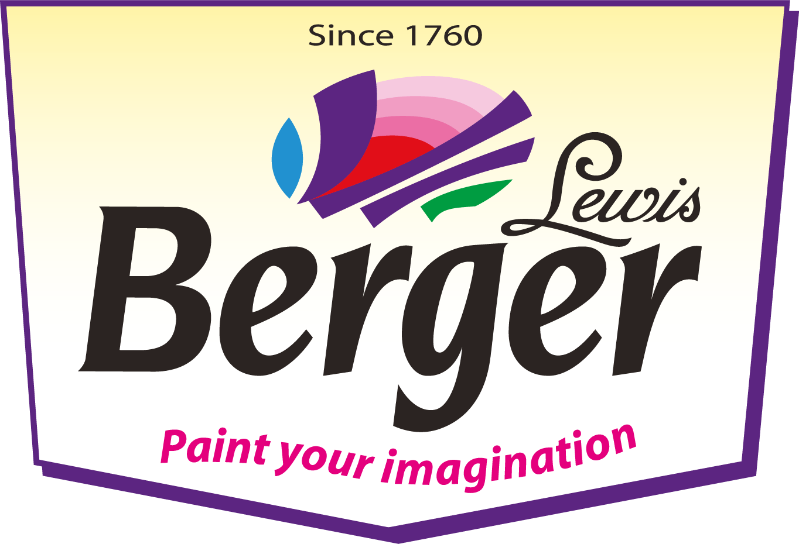
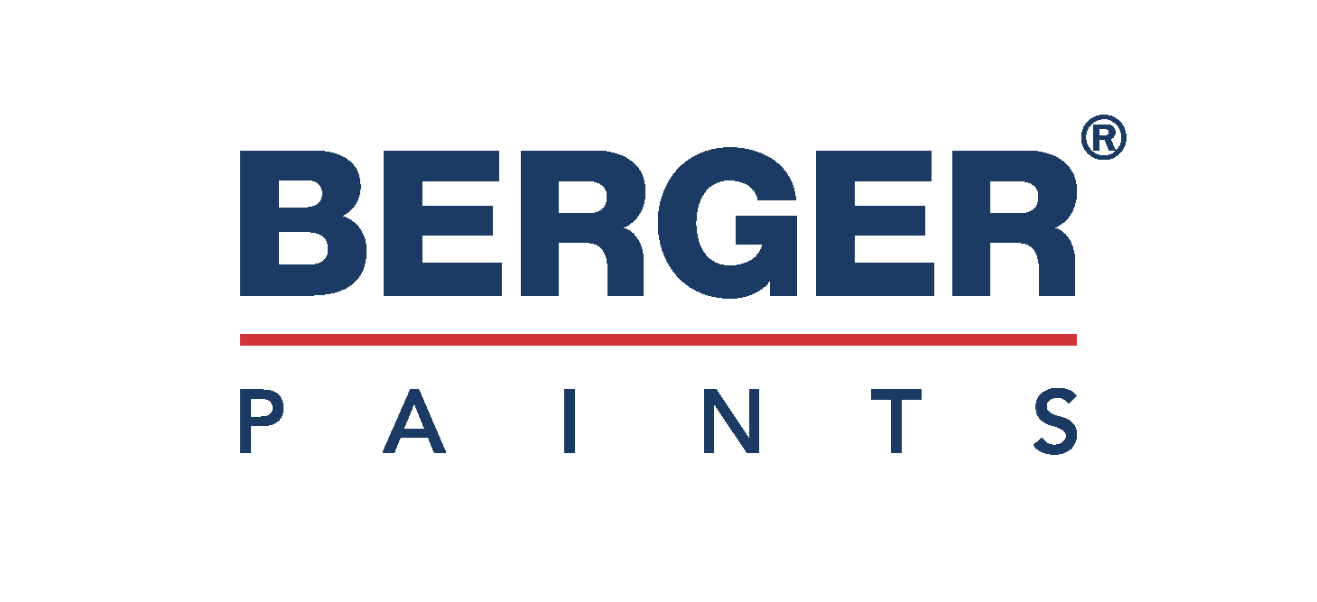
Berger Paints Analysis
By Rohit Sul

Slide 2
About the Berger Paint
Berger Paints – A Legacy of Color & Excellence Since 1760s
From crafting Prussian Blue pigment in 18th century London to becoming India’s 2nd largest paint company, Berger Paints has come a long way!
Historic Roots: Founded by Lewis Berger, a visionary German chemist in the 1760s, Berger Paints was introduced to India as Hadfield’s (India) Ltd in Kolkata.
Strong Financials:
Net Profit Margin: ~11–13% – reflecting robust operational efficiency
EBITDA Margin: 15–18% – showcasing strong profitability before interest & tax

Slide 3
Problem Statement:
Optimizing Product Profitability and Customer Value for Berger Paints
Context: Berger Paints has a wide portfolio of products catering to various customer segments across India. The organization has access to detailed sales, inventory, discount, and profitability data, which is visualized in the above dashboard.

Slide 4
Berger Category Paint
Spray Paint
Definition: Aerosol paint applied using a spray can for smooth and quick coverage.
Example: Spray paint used for graffiti art or quick touch-ups on furniture.
Wood Paint
Definition: Paint specifically designed to penetrate or coat wood surfaces, protecting them from moisture and decay.
Example: Varnish or polyurethane paint applied on wooden doors or cabinets.

Slide 5
Berger Category Paint
Interior Paint
Definition: Paint used for the walls and ceilings inside buildings. It usually has low odor and comes in various finishes (matte, glossy).
Example: Water-based emulsion paint used in bedrooms or offices.
Metal Paint
Definition: Paint that provides a protective and decorative finish on metal surfaces, often containing rust inhibitors.
Example: Oil-based enamel paint used on iron railings or steel furniture.
Specialty Paint
Definition: Paints formulated for specific uses like heat resistance, glow-in-the-dark effects, or magnetic properties.
Example: Chalkboard paint used to create writable surfaces.

Slide 6
Berger Category Paint
Eco-Friendly Paint
Definition: Paint made with natural ingredients and low levels of volatile organic compounds (VOCs), making it safe for the environment and human health.
Example: A paint made from plant oils and natural pigments used in nurseries or hospitals.
Exterior Paint
Definition: Paint formulated to withstand outdoor conditions like rain, sun, and temperature changes.
Example: Acrylic latex paint used for painting house walls, fences, or gates.
Industrial Paint
Definition: Durable coatings designed for machinery, equipment, and industrial surfaces to resist chemicals, corrosion, and wear.
Example: Epoxy paint used in manufacturing plants or warehouses.

